Slide 1
Virtual Machines and Runtime
Using Rhino as an example

Slide 2
What is a Virtual Machine?
A virtual machine is a software-defined computer whose purpose is to simulate a physical machine, running on a « host » machine as a « guest ».
Hardware simulated: CPU, memory, hard drive, network interfaces, etc.
Source: https://www.vmware.com/topics/glossary/content/virtual-machine

Slide 3
Types of Virtual Machines
System virtual machine
Process virtual machine
Used to substitute a physical machine
Using an hypervisor that can run directly on hardware (VMware ESXI) or on top of an OS (VirtualBox).
Used for executing a single process
Masks the information of the underlying hardware/OS
Java Virtual Machine

Slide 4
Java Virtual Machine (JVM)
Virtual Machine that allows the execution of programs compiled to Java bytecode.
Follows a standard required in a JVM implementation.
The JVM simulates a 32-bit machine.
Offers a garbage collector for removing dereferenced objects.

Slide 5
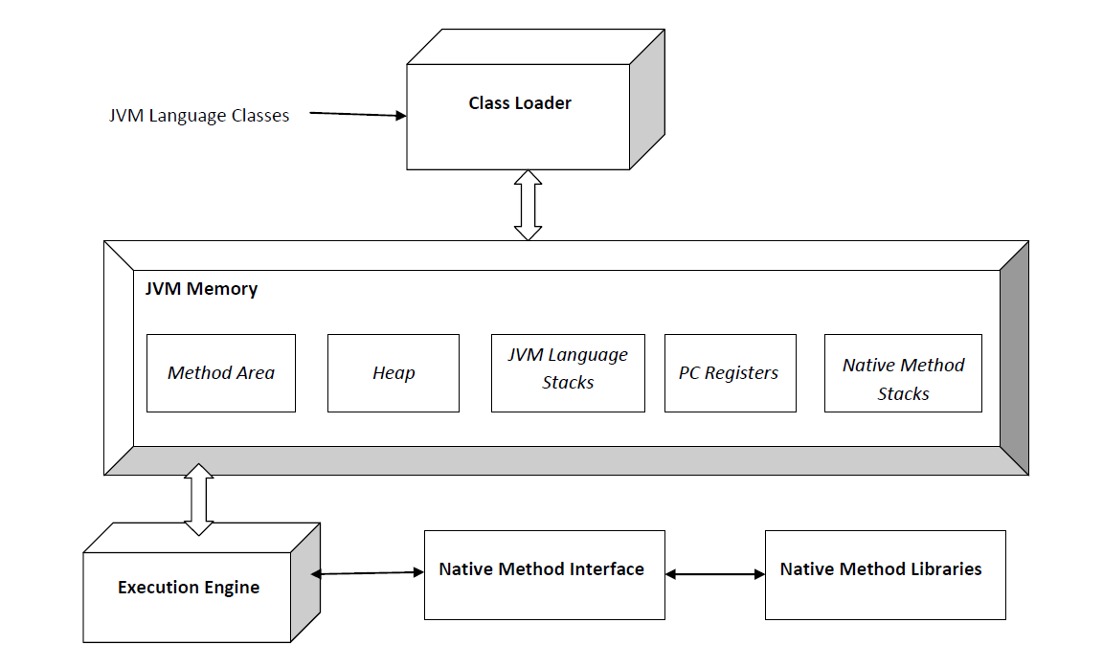
Java Virtual Machine (JVM)

Slide 6
Runtime Environment (RTE)
The runtime of a program is the execution and running phase.
A Runtime Environment provides all the functionalities and dependencies necessary to run a program independently of the underlying operating system, which allows the program to have the same user interfaces regardless of the OS.
Provides basic functions for memory, network and hardware.
Source: https://www.ionos.com/digitalguide/websites/web-development/what-is-a-runtime-environment

Slide 7
Java Runtime Environment (JRE)
Combines the Java code created with the JDK with the dependencies required (libraries) and creates an instance of the JVM to run the resulting program.
Enables a Java program to run in any OS without modification.
Source:
https://www.ibm.com/cloud/learn/jre
Architecture:
ClassLoader: loads all the classes of the Java program.
Bytecode verifier: Checks the format and accuracy of the Java code.
Interpreter

Slide 8
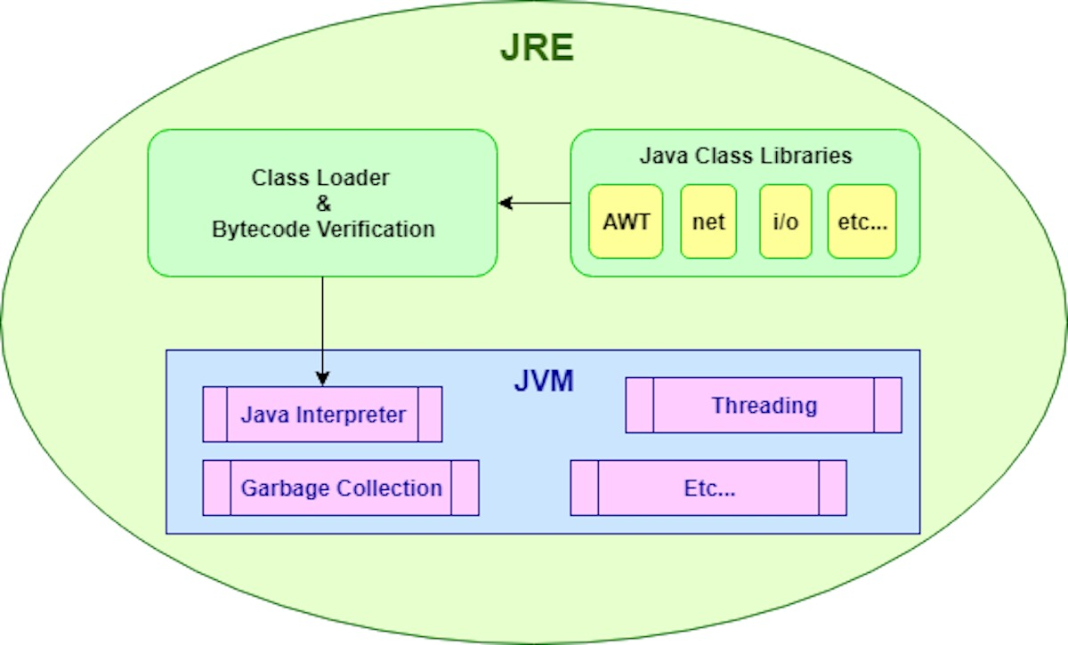
Java Runtime Environment (JRE)

Slide 9
Interpreter vs Compiler
Interpreter
Compiler
Translates program at runtime, one statement at a time.
Source: https://www.programiz.com/article/difference-compiler-interpreter
Scans the program and translates it into machine code.

Slide 10
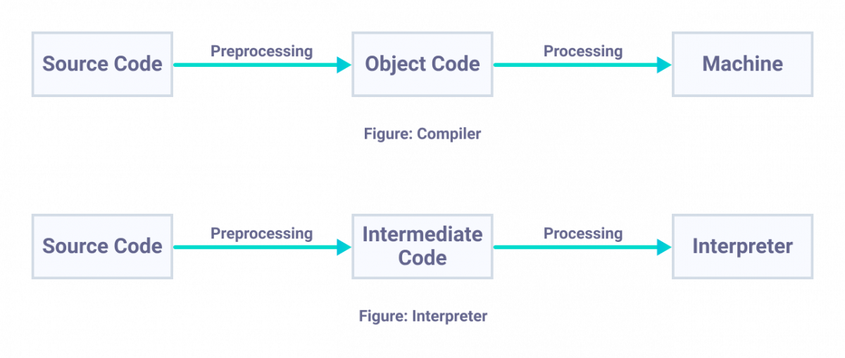
Interpreter vs Compiler

Slide 11
Compiler
A compiler is a program that translates source code into another lower-level language.
Different types of compilers: TODO

Slide 12
Phases of a Compiler
Front end
Back end
Lexical Analysis
Syntax Analysis
Semantic Analysis
Intermediate Code Generation
Optimization
Code Generation

Slide 13
Just-In-Time (JIT) Compiler
Used to improve the performance of Java applications.
Compiles « just in time » bytecodes into native machine code at runtime.
The JVM calls the compiled code instead of interpreting it.
Source: https://www.ibm.com/support/knowledgecenter/SSYKE2_7.1.0/com.ibm.java.aix.71.doc/diag/understanding/jit_overview.html
https://www.freecodecamp.org/news/just-in-time-compilation-explained/

Slide 14
JIT usual optimizations
Loops
Function calls

Slide 15
Benchmarks performed
Benchmark performed on two big arrays:
Array of native type (int)
Array of two different objects (boxed ints)
Focus on the loop iteration performance by going through all elements of the arrays.
Focus on the access to a variable boxed/non boxed by a class.

Slide 16

The Rhino Project
A JavaScript Runtime

Slide 17
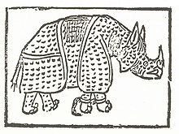
The Rhino Project: History
Created by Netscape in the autumn of 1997.
Great performance but heavy compilation time and memory-leak issues.
Interpretive mode created in 1998.
Released to Mozilla Foundation in April 1998: Rhino becomes open source.

Slide 18
Rhino, a Javascript Runtime
Open-source implementation of JavaScript written in Java.
Rhino compile JavaScript scripts to Java Bytecode which will run on a JVM.
An interpretive mode is supported: the generated compiled code is represented as an object that can be garbadge collected.
Allows the use of Java libraries, also called « Scripting Java ».

